Slide 1

Machine Learning-Based Prediction of Metabolic Cost During Human Walking
UE24CS352A · Machine Learning Mini-Project
Notes:
Introduce the project: we predict how much energy a person spends per kilogram per metre when walking, using machine learning on a prepared dataset.

Slide 2
The Problem and the Goal
Metabolic cost is the energy used per kilogram per metre walked (J/kg/m).
Task: supervised regression from walking context, joint mechanics and muscle activity.
Questions: which signals carry the most information, and do models beat simply predicting the average?
Test: performance on people the model has never seen.
4
feature groups compared
5
regression models, incl. a baseline
4
metrics: MSE, RMSE, MAE, R²
Notes:
Frame the problem as supervised regression. Stress the three headline numbers: 4 feature groups, 5 models, 4 metrics.

Slide 3



Dataset and Cleaning
Prepared CSV
Missing target
Duplicate check
One row per walking trial, with subject and trial identifiers. Target: metabolic_cost_J_kg_m. The raw MATLAB .mat files are not used directly.
One row has no metabolic-cost value. A supervised model cannot learn from it, so the row is dropped instead of inventing a target.
A right-side column is dropped only if it matches its left-side twin in every row. Otherwise both sides stay. Other gaps are median-imputed inside each pipeline.
Notes:
Explain why we drop the single row with a missing target, and why we never assume left and right columns are duplicates.

Slide 4
End-to-End Pipeline
1
Upload and inspect
2
Clean
3
Build feature groups
Load the prepared CSV; check shape, missing values and trials per subject.
Drop the row with a missing target and any verified duplicate columns.
Context, Kinematics + GRF, EMG, and All.
4
Train and validate
5
Score
6
Plot and export
5 models × 4 feature sets with Leave-One-Subject-Out CV.
MSE, RMSE, MAE and R² on all out-of-fold predictions.
Comparison charts, feature importance, CSV tables and a ZIP download.
Notes:
Walk through the six notebook stages left to right, top to bottom.

Slide 5



Four Feature Groups
Context
Kinematics + GRF
EMG
All
Walking speed, incline code and trial duration. What the task conditions alone can explain.
Context, plus joint angles, velocities and moments from both sides, plus ground-reaction-force features.
Context, plus muscle-activation features from both sides.
Every group combined: the richest and highest-dimensional input.
Notes:
Left and right measurements are both kept unless a pair is proven identical. Feature counts are printed by the notebook at run time.

Slide 6
Five Regression Models
Model | Type | Key settings | Preprocessing
Dummy Mean | Baseline | Always predicts the training mean | Median impute
Ridge | Linear | alpha = 1.0 | Median impute + standardise
SVR | Kernel | RBF kernel, C = 10, epsilon = 0.1, gamma = scale | Median impute + standardise
Random Forest | Bagged trees | 300 trees, max_features = sqrt, min leaf = 2, seed 42 | Median impute
Gradient Boosting | Boosted trees | 100 stages, learning rate 0.03, depth 2, min leaf 2, Huber loss | Median impute
Notes:
The mean baseline tells us whether any ML model really improves on predicting the average. Imputing and scaling happen inside each pipeline.

Slide 7
Leave-One-Subject-Out Validation
S1
S2
S3
…
SN
No subject overlap. Trials from one person never sit in both training and test sets.
Fold 1
Test
Train
Train
…
Train
Fold 2
Train
Test
Train
…
Train
No leakage. Imputing and scaling are learned on the training fold only.
Fold N
Train
Train
Train
…
Test
One honest score. Metrics are computed once on all out-of-fold predictions.
Test = the held-out subject. Train = every other subject.
Notes:
Explain that a random split would put the same person in train and test and give over-optimistic results. LOSO measures generalisation to new people.

Slide 8
Four Evaluation Metrics
MSE
RMSE
MAE
R²
Mean squared error
Root mean squared error
Mean absolute error
Variance explained
Average squared gap between actual and predicted. Penalises large misses.
Square root of MSE, in J/kg/m. Used to rank every configuration.
Average absolute gap. Easy to read and less sensitive to outliers.
Improvement over predicting the mean. At or below 0 means no better than the baseline.
Notes:
Target is continuous, so we report regression metrics. The best non-baseline configuration is the one with the lowest RMSE.

Slide 9
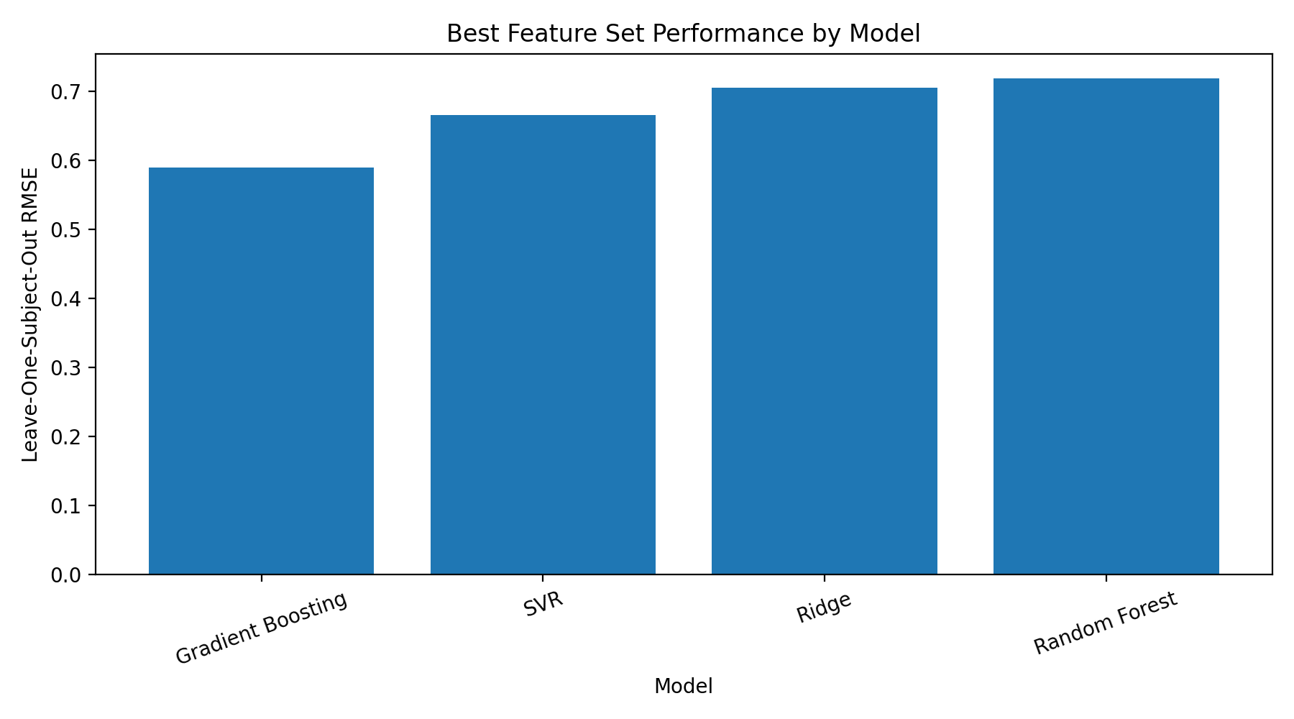
Results: Gradient Boosting Wins
≈ 0.59
lowest RMSE (J/kg/m): Gradient Boosting with Context features
≈ 0.72
highest RMSE among the four: Random Forest
RMSE values are read from the chart. MAE and R² are in the notebook's Section 10 and 11 output.
Notes:
Gradient Boosting has the lowest Leave-One-Subject-Out RMSE, about 0.59. SVR and Ridge follow, and Random Forest is highest at about 0.72. Quote the exact MAE and R2 from your notebook output.

Slide 10
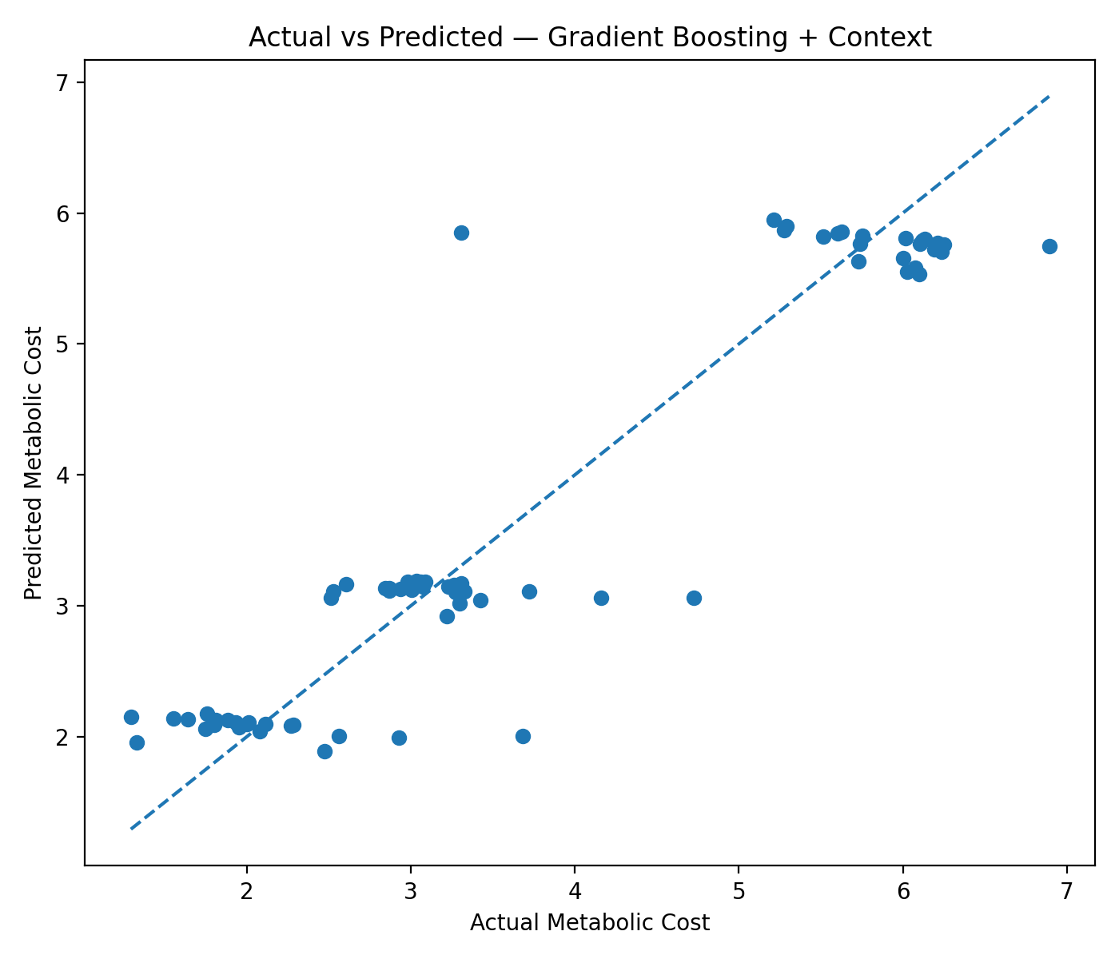
Actual vs Predicted
Best model. Gradient Boosting with the Context features.
Banded predictions. Outputs cluster near 2, 3 and 5.8 instead of following the dashed y = x line.
Biggest misses. The highest-cost trial (6.9) and one trial near 3.3 predicted as 5.8.
Notes:
Points on the dashed line would be perfect predictions. Here the model predicts in a few levels, which fits Context features dominated by one variable.

Slide 11
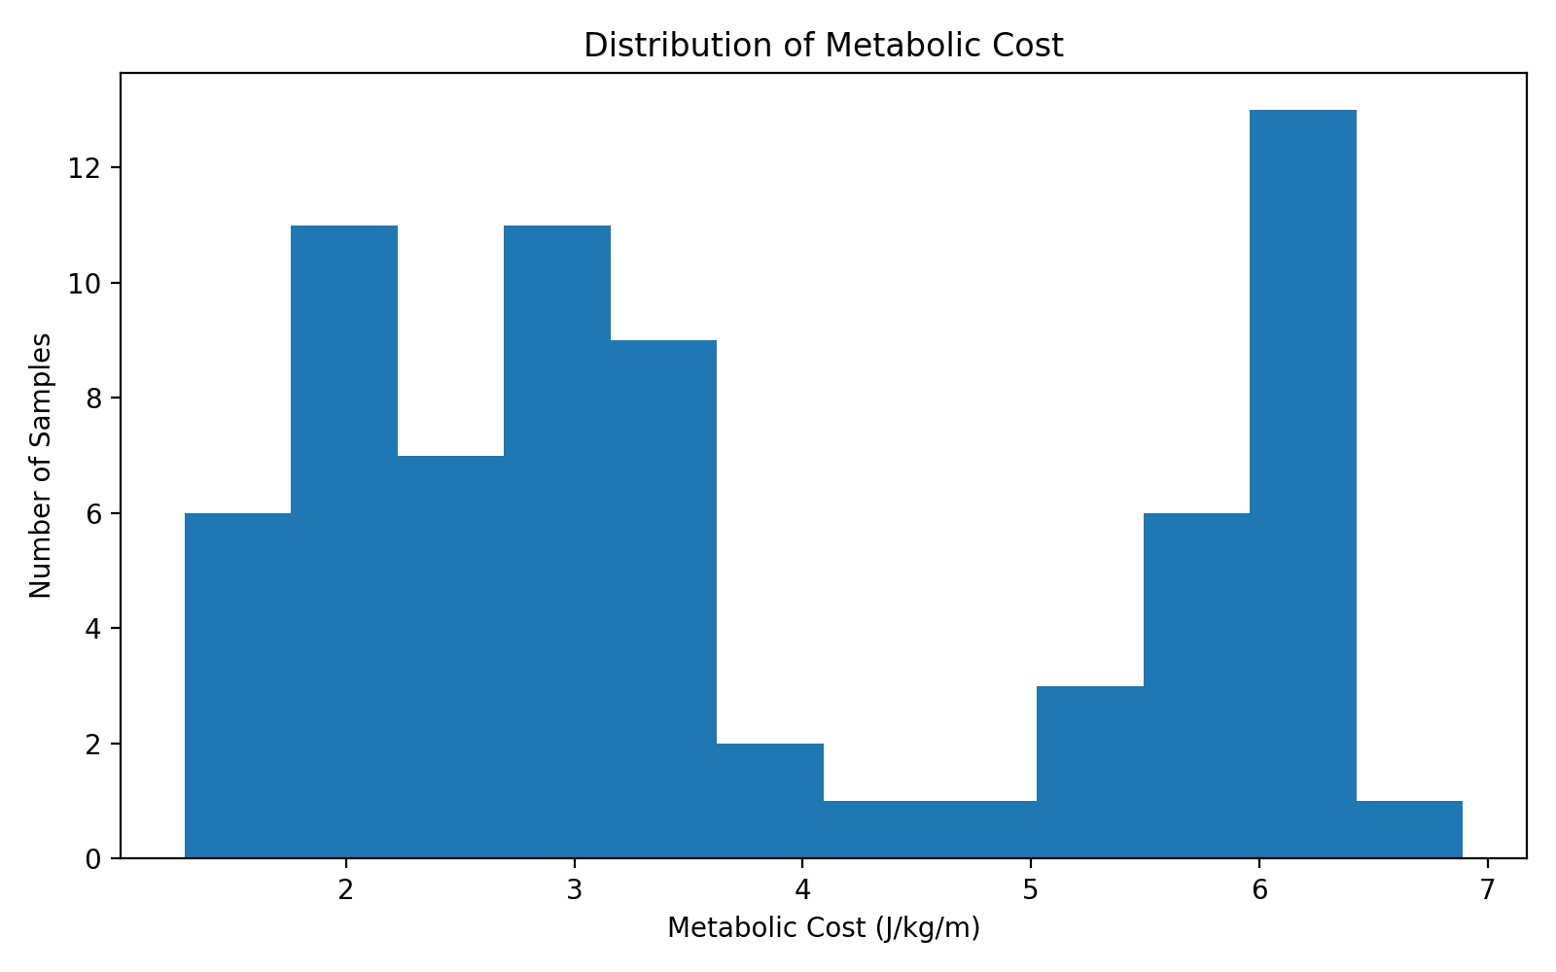
Target Distribution
Two clusters. Most trials fall between 1.5 and 3.6; another group sits between 5 and 6.5.
Sparse middle. Very few trials between 4 and 5, so mid-range costs are rarely seen.
Small dataset. About 71 samples in total, summed from the histogram bars.
Notes:
The target is bimodal. With so few samples in the gap, models struggle with mid-range values.

Slide 12
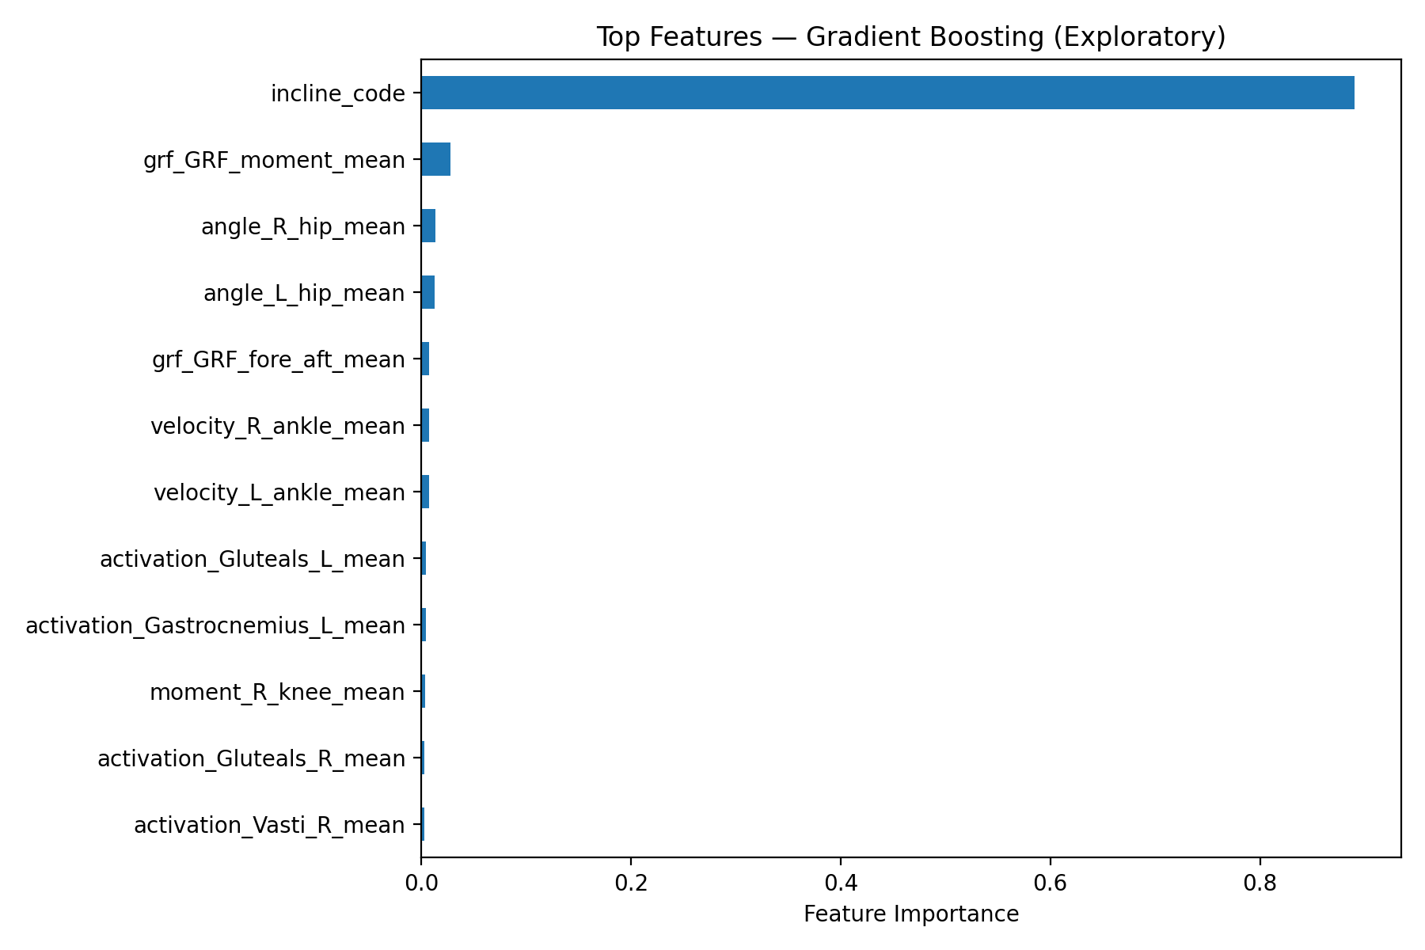
What Drives the Prediction
One dominant feature. incline_code scores about 0.89.
Long tail. The next feature, grf_GRF_moment_mean, is only about 0.03, followed by hip angles.
Exploratory only. Fitted on all rows, so it describes the model, not test performance.
Notes:
This is consistent with the Context feature set winning: incline carries most of the signal. Remember it is not a test-set result.

Slide 13
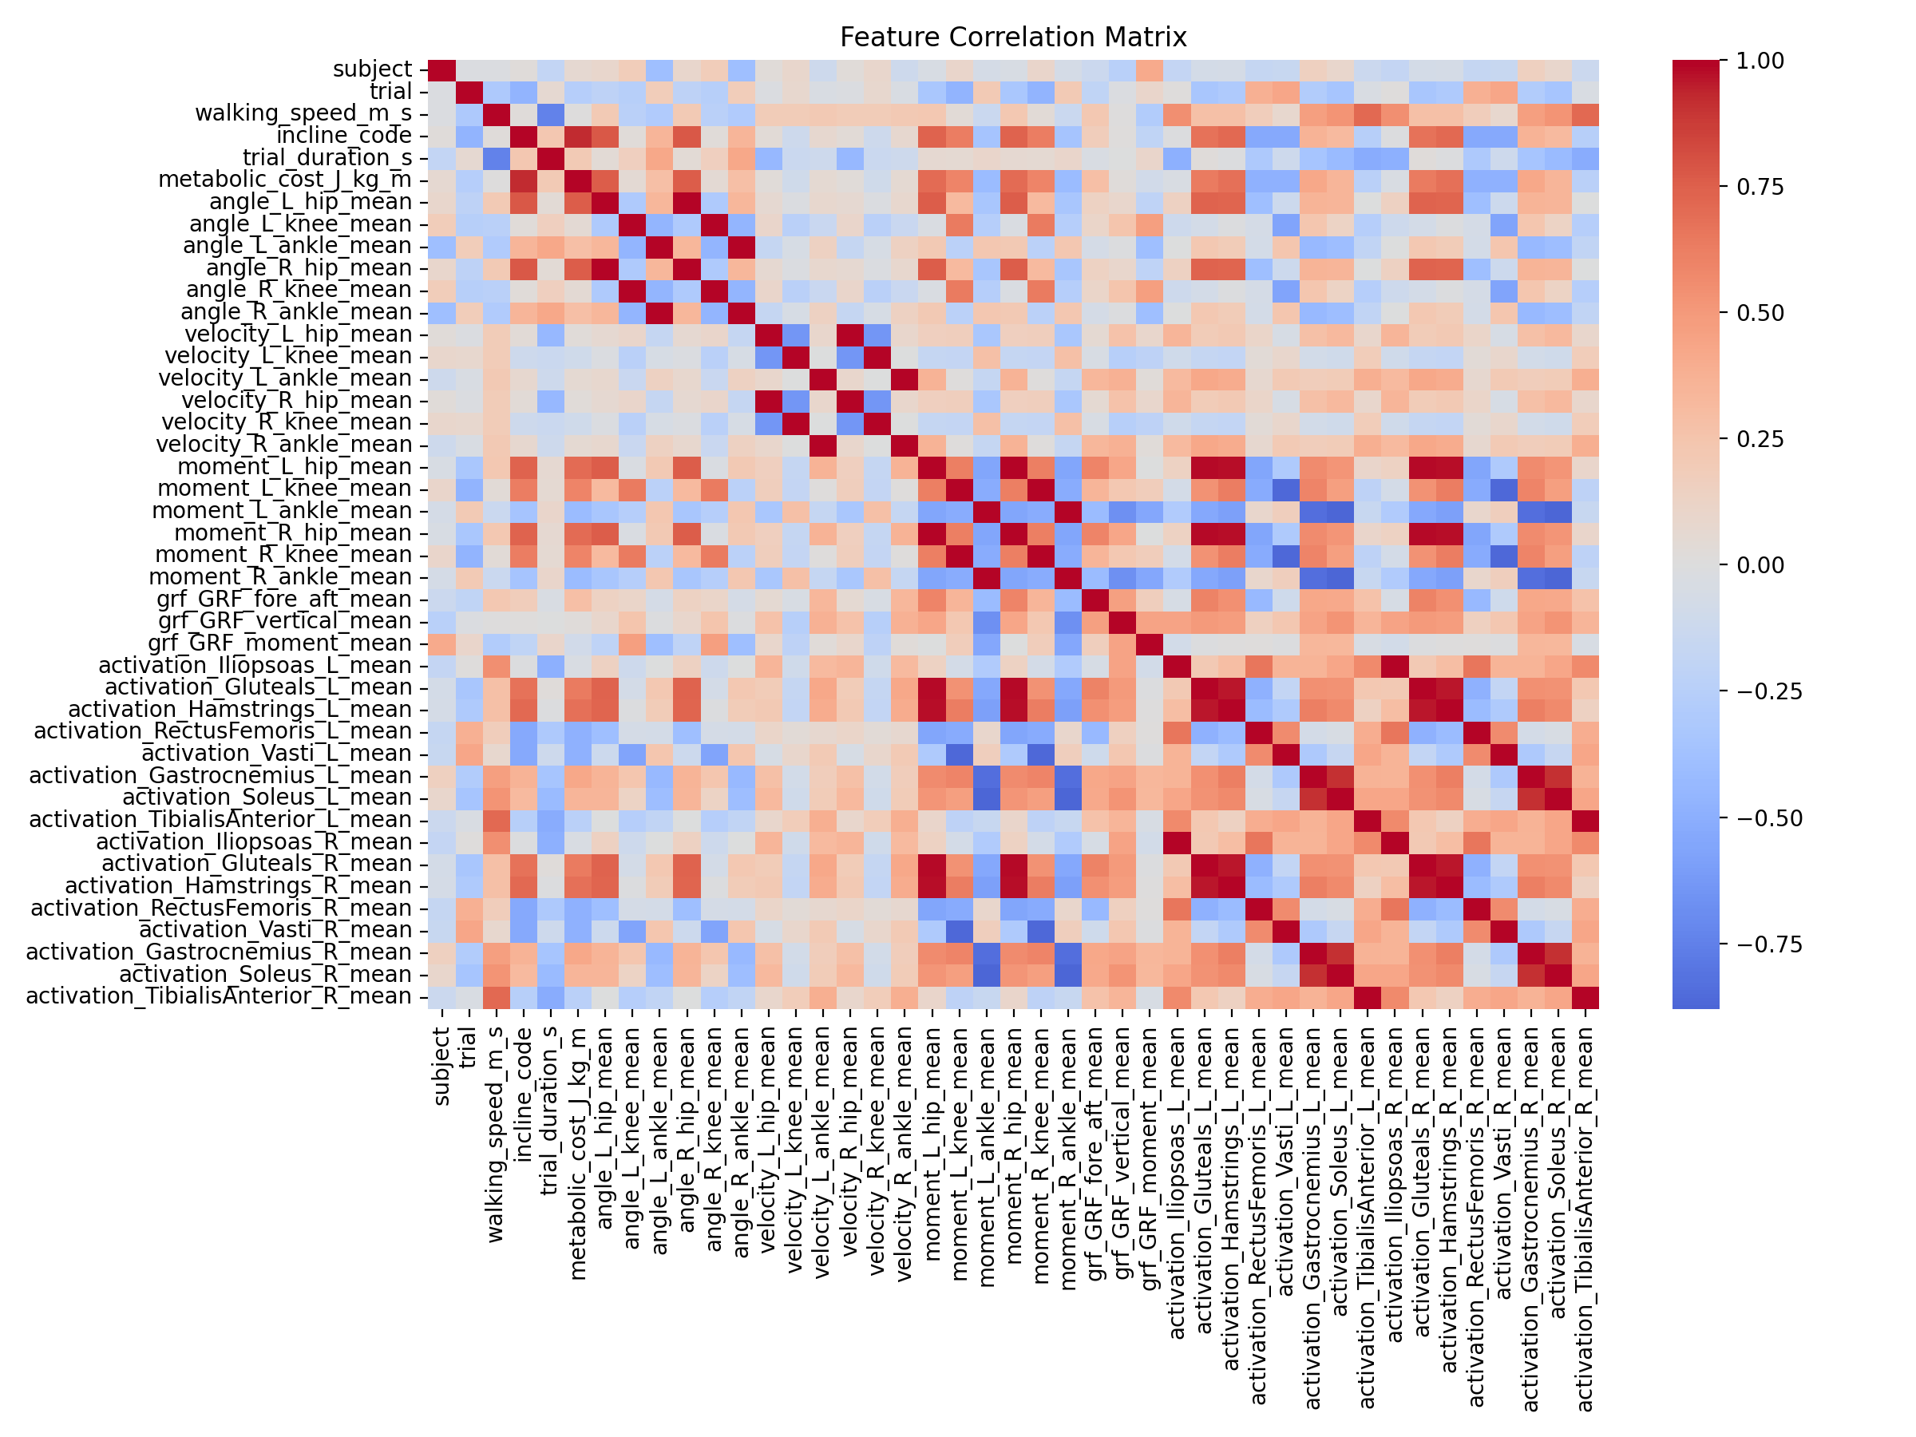
Correlation Structure
Target link. metabolic_cost_J_kg_m correlates strongly with incline_code.
Left and right agree. The same joint or muscle on both legs is often highly correlated.
Overlapping signals. Dark blocks mean many features carry similar information.
Notes:
Labels are small on this overview; the point is the block structure and the strong incline link.

Slide 14


Limitations and Next Steps
Limitations
Possible next steps
Built from the prepared CSV, not the raw MATLAB .mat files
Only about 71 samples from one dataset, so scores may not generalise
Feature importance is exploratory: fitted on all rows
Hyperparameters are fixed, not tuned
Tune hyperparameters with nested subject-wise CV
Rebuild features directly from the .mat recordings
Report per-subject errors, not only pooled scores
Test on new subjects or walking conditions
Notes:
Be upfront about scope: results are specific to this dataset and procedure.

Slide 15



Summary
Metabolic-cost prediction framed as supervised regression
Fair comparison: 4 feature groups × 5 models under Leave-One-Subject-Out CV
Gradient Boosting + Context scored the lowest RMSE (≈ 0.59), and incline_code dominates
In one breath: we drop rows with a missing target, keep left and right measurements unless proven identical, compare feature groups and models, and evaluate with Leave-One-Subject-Out cross-validation using MSE, RMSE, MAE and R².
Notes:
Close with the one-breath summary. Then take questions.

